Slide 1


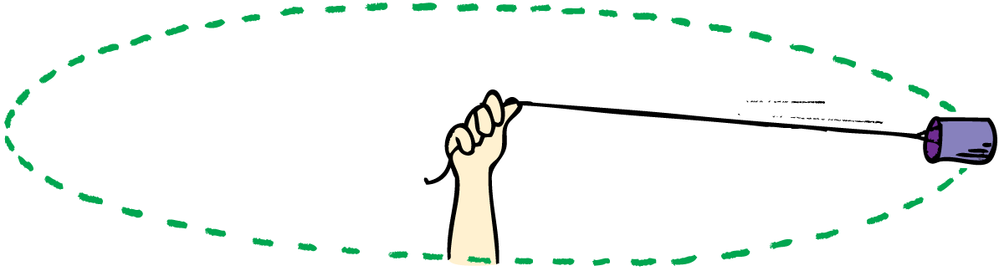
Circular Motion Notes
Centripetal force keeps an object in circular motion.

Slide 2
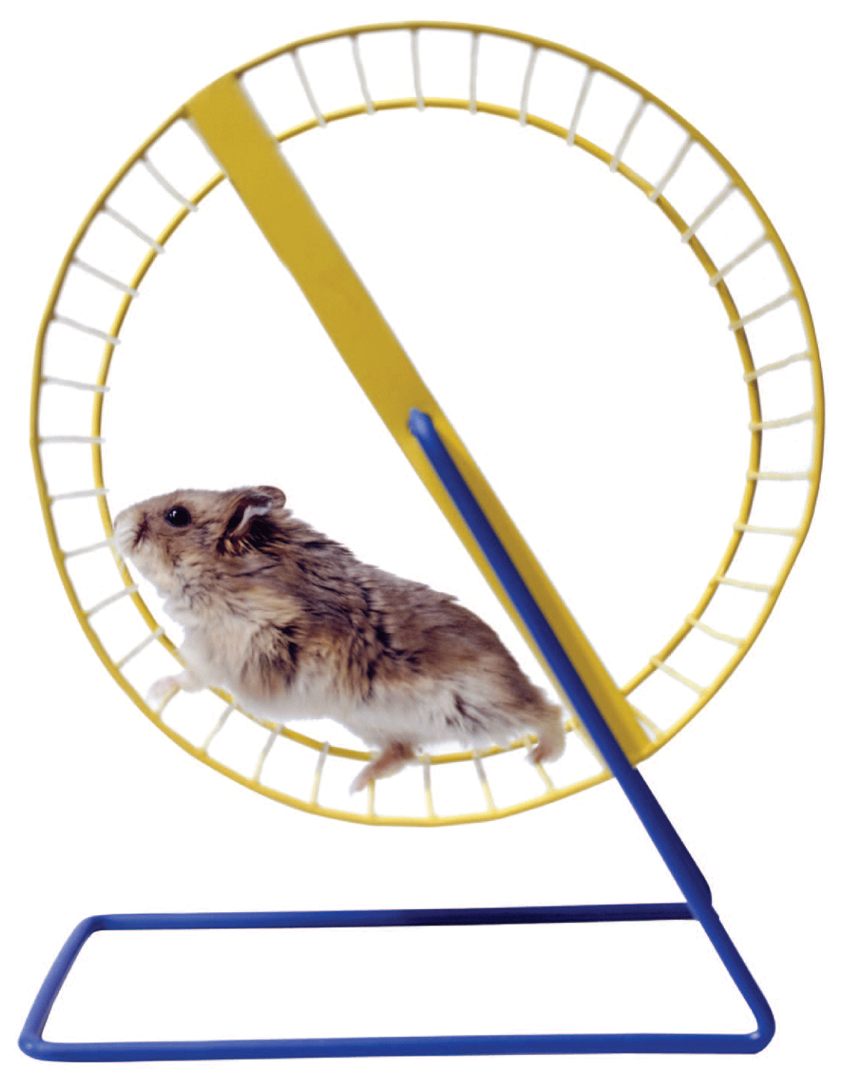
Which moves faster on a merry-go-round, a horse near the outside rail or one near the inside rail?
While a hamster rotates its cage about an axis, does the hamster rotate or does it revolve about the same axis?
We begin to answer these questions by discussing the difference between rotation and revolution.

Slide 3
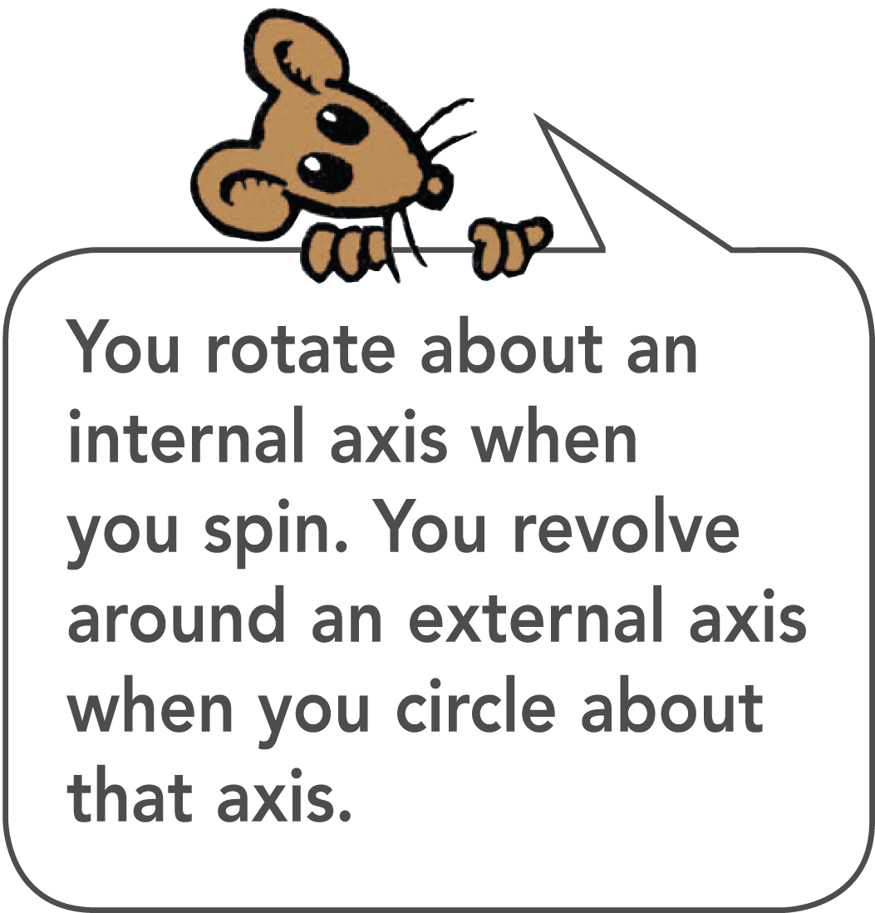
Rotation and Revolution
There are two types of circular motion, rotation and revolution
An axis is the straight line around which rotation takes place.
When an object turns about an internal axis—that is, an axis located within the body of the object—the motion is called rotation, or spin.
When an object turns about an external axis, the motion is called revolution.

Slide 4
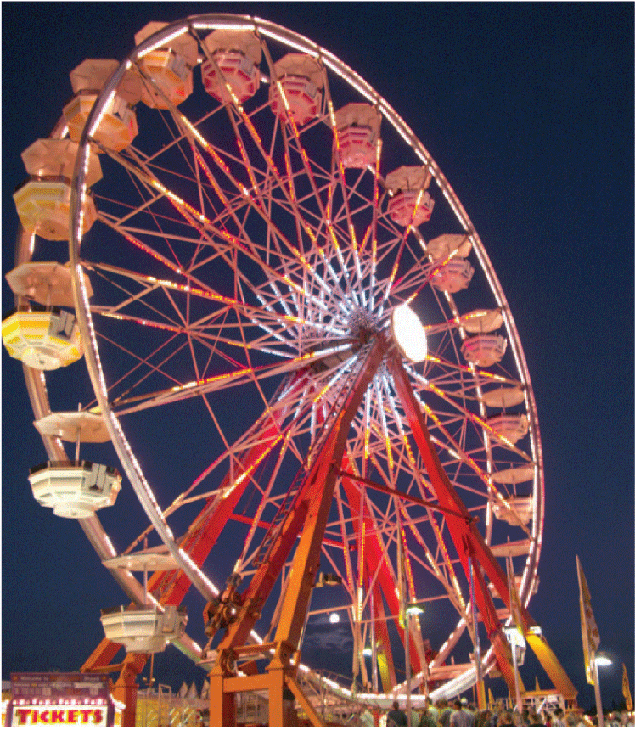
Rotation and Revolution
The Ferris wheel turns about an axis.
The Ferris wheel rotates, while the riders revolve about its axis.

Slide 5
Rotation and Revolution – Earth Example
Earth undergoes both types of rotational motion.
It revolves around the sun once every 365 ¼ days.
It rotates around an axis passing through its geographical poles once every 24 hours.

Slide 6
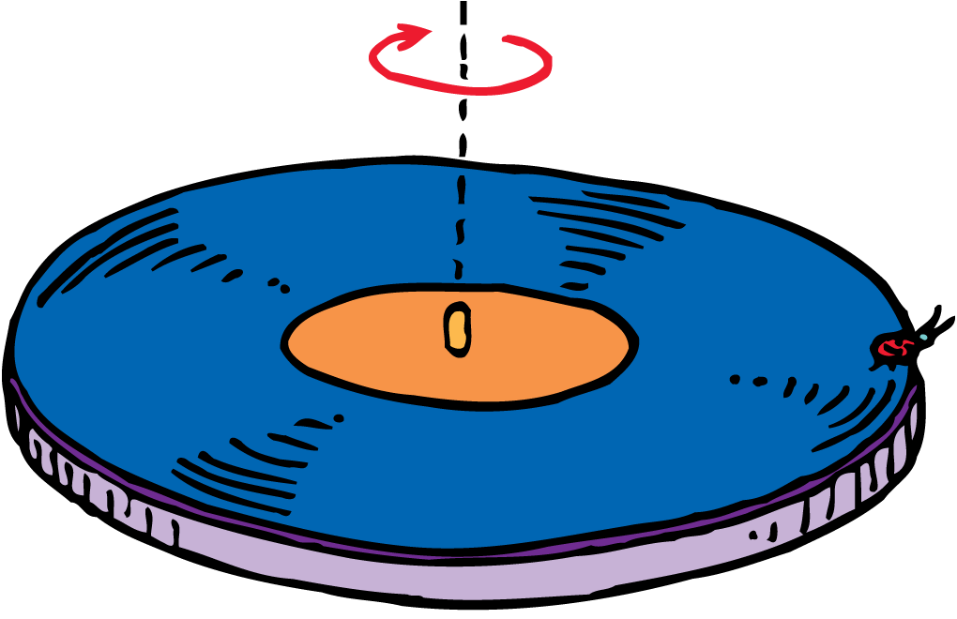
Rotational Speed
Tangential speed depends on rotational speed and the distance from the axis of rotation.
The turntable rotates around its axis while a ladybug sitting at its edge revolves around the same axis.

Slide 7
Ladybug example
Which part of the turntable moves faster—the outer part where the ladybug sits or a part near the orange center?
It depends on whether you are talking about linear speed or rotational speed.

Slide 8
Types of Speed
Linear speed is the distance traveled per unit of time.
A point on the outer edge of the turntable travels a greater distance in one rotation than a point near the center.
The linear speed is greater on the outer edge of a rotating object than it is closer to the axis.
The speed of something moving along a circular path can be called tangential speed because the direction of motion is always tangent to the circle.

Slide 9
Types of Speed
Rotational speed (sometimes called angular speed) is the number of rotations per unit of time.
All parts of the rigid turntable rotate about the axis in the same amount of time.
All parts have the same rate of rotation, or the same number of rotations per unit of time. It is common to express rotational speed in revolutions per minute (RPM).

Slide 10
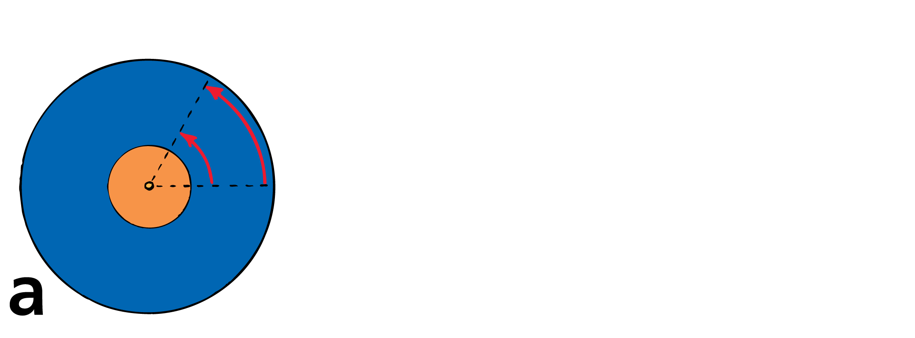
Back to Ladybug example
All parts of the turntable rotate at the same rotational speed.
A point farther away from the center travels a longer path in the same time and therefore has a greater tangential speed.

Slide 11
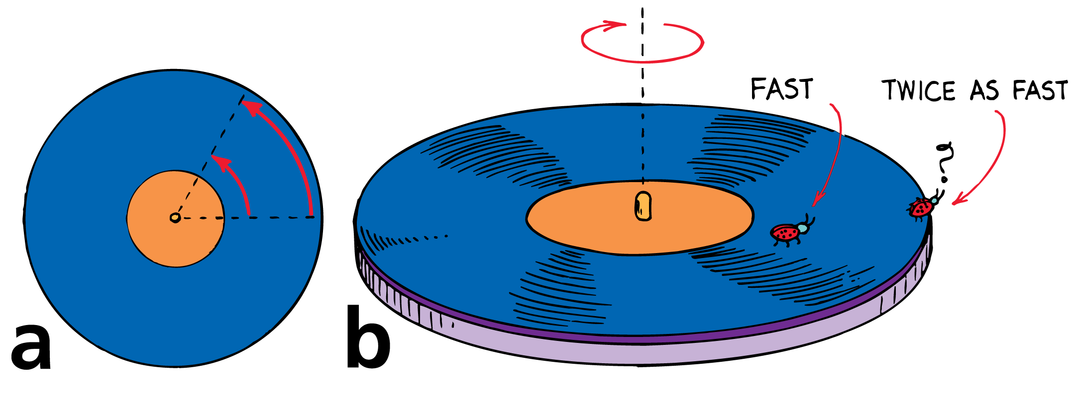
Back to Ladybug example
All parts of the turntable rotate at the same rotational speed.
A point farther away from the center travels a longer path in the same time and therefore has a greater tangential speed.
A ladybug sitting twice as far from the center moves twice as fast.

Slide 12
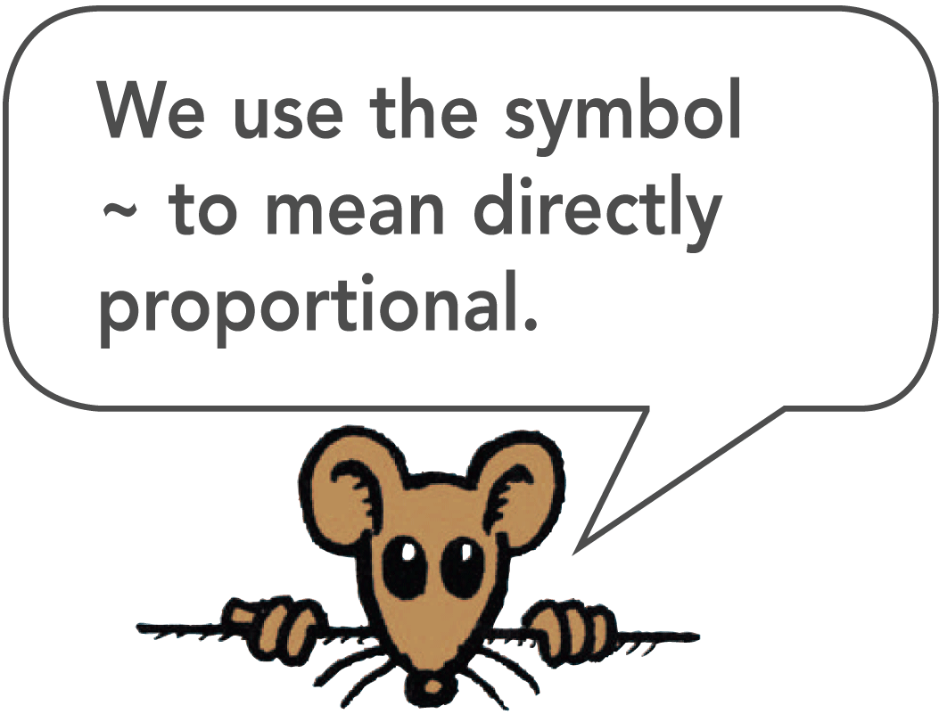
Tangential and Rotational Speed
Tangential speed and rotational speed are related. Tangential speed is directly proportional to the rotational speed and the radial distance from the axis of rotation.
Tangential speed ~ radial distance × rotational speed

Slide 13
Rotational Speed Calculation
In symbol form,
v ~ rω
where v is tangential speed and ω (pronounced oh MAY guh) is rotational speed.
You move faster if the rate of rotation increases (bigger ω).
You also move faster if you are farther from the axis (bigger r).

Slide 14
Rotational Speed Calculation
At the axis of the rotating platform, you have no tangential speed, but you do have rotational speed. You rotate in one place.
As you move away from the center, your tangential speed increases while your rotational speed stays the same.
Move out twice as far from the center, and you have twice the tangential speed.

Slide 15
think!
At an amusement park, you and a friend sit on a large rotating disk. You sit at the edge and have a rotational speed of 4 RPM and a linear speed of 6 m/s. Your friend sits halfway to the center. What is her rotational speed? What is her linear speed?

Slide 16
think!
At an amusement park, you and a friend sit on a large rotating disk. You sit at the edge and have a rotational speed of 4 RPM and a linear speed of 6 m/s. Your friend sits halfway to the center. What is her rotational speed? What is her linear speed?
Answer:
Her rotational speed is also 4 RPM, and her linear speed is 3 m/s.

Slide 17

Centripetal Force
The centripetal force on an object depends on the object’s tangential speed, its mass, and the radius of its circular path.

Slide 18
Centripetal Force
Velocity involves both speed and direction.
When an object moves in a circle, even at constant speed, the object still undergoes acceleration because its direction is changing.
This change in direction is due to a net force (otherwise the object would continue to go in a straight line).
Any object moving in a circle undergoes an acceleration that is directed to the center of the circle—a centripetal acceleration.

Slide 19
Centripetal Force
Centripetal means “toward the center.”
The force directed toward a fixed center that causes an object to follow a circular path is called a centripetal force.

Slide 20
Examples of Centripetal Forces
If you whirl a tin can on the end of a string, you must keep pulling on the string—exerting a centripetal force.
The string transmits the centripetal force, pulling the can from a straight-line path into a circular path.

Slide 21
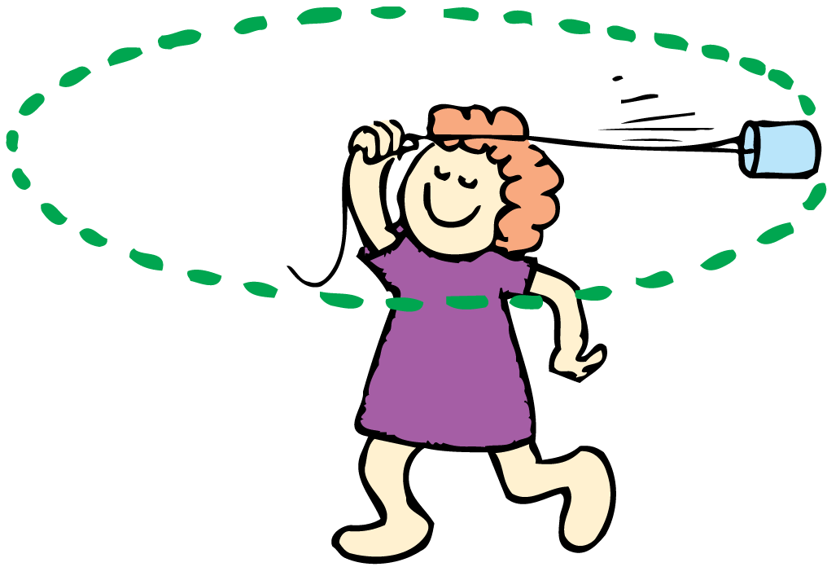
Examples of Centripetal Forces
The force exerted on a whirling can is toward the center. No outward force acts on the can.

Slide 22
Examples of Centripetal Forces
Centripetal forces can be exerted in a variety of ways.
The “string” that holds the moon on its almost circular path, for example, is gravity.
Electrical forces provide the centripetal force acting between an orbiting electron and the atomic nucleus in an atom.
Anything that moves in a circular path is acted on by a centripetal force.

Slide 23
Centripetal Force
Centripetal force is not a basic force of nature, but is the label given to any force that is directed toward a fixed center.
If the motion is circular and executed at constant speed, this force acts at right angles (tangent) to the path of the moving object.

Slide 24
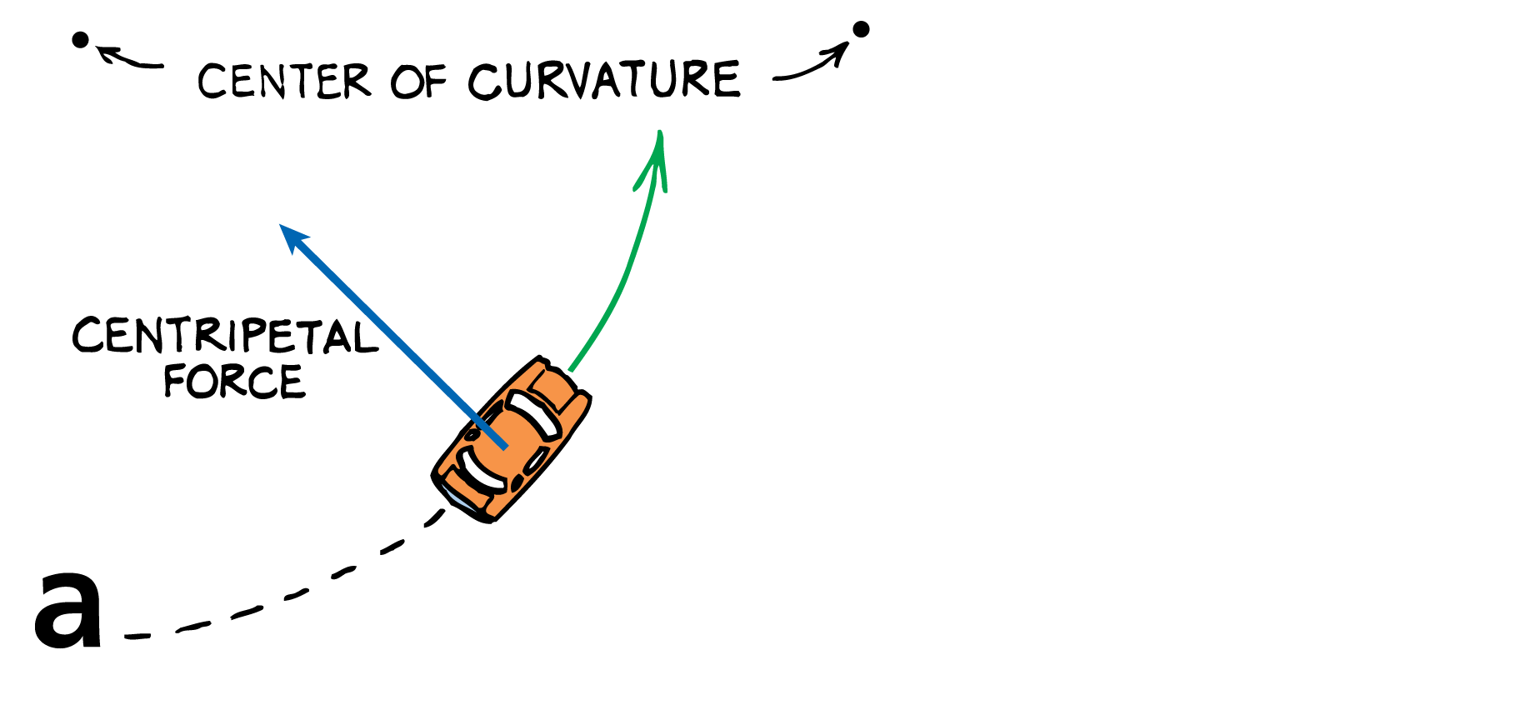
Centripetal Force
Centripetal force holds a car in a curved path.
For the car to go around a curve, there must be sufficient friction to provide the required centripetal force.

Slide 25
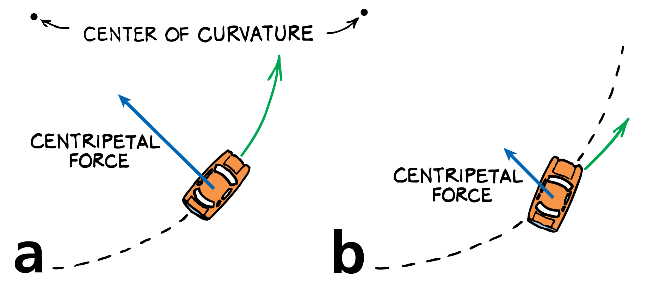
10.3 Centripetal Force
Centripetal force holds a car in a curved path.
For the car to go around a curve, there must be sufficient friction to provide the required centripetal force.
If the force of friction is not great enough, skidding occurs.

Slide 26
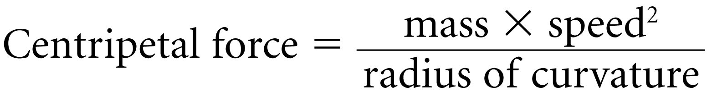
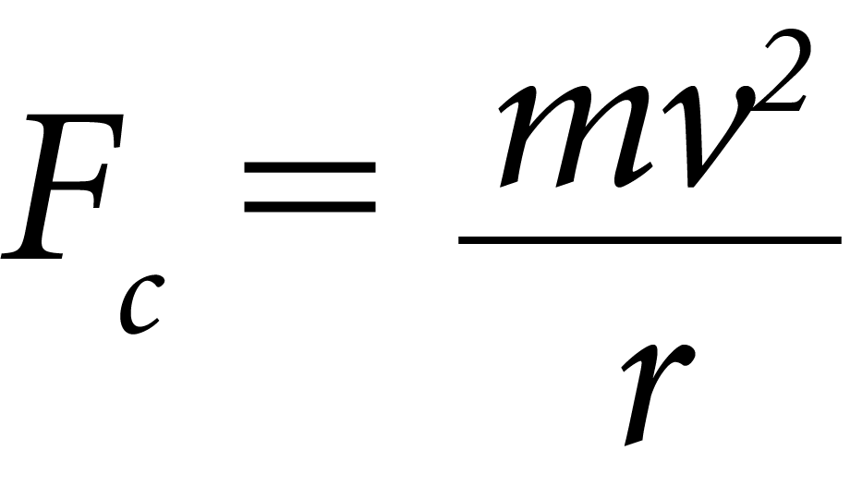
Calculating Centripetal Forces
Greater speed and greater mass require greater centripetal force.
Traveling in a circular path with a smaller radius of curvature requires a greater centripetal force.
Centripetal force, F_{c}, is measured in newtons when m is expressed in kilograms, v in meters/second, and r in meters.

Slide 27
Centripetal and Centrifugal Forces
The “centrifugal-force effect” is attributed not to any real force but to inertia—the tendency of the moving body to follow a straight-line path.

Slide 28
Centripetal and Centrifugal Forces
Sometimes an outward force is also attributed to circular motion.
This apparent outward force on a rotating or revolving body is called centrifugal force. Centrifugal means “center-fleeing,” or “away from the center.”

Slide 29
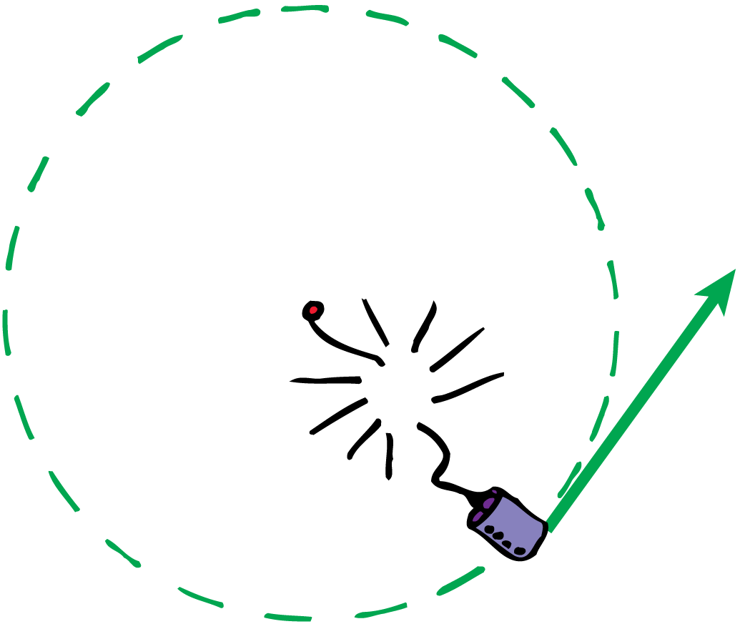
Centripetal and Centrifugal Forces - Example
When the string breaks, the whirling can moves in a straight line, tangent to—not outward from the center of—its circular path.

Slide 30
Centripetal and Centrifugal Forces
In the case of the whirling can, it is a common misconception to state that a centrifugal force pulls outward on the can.
In fact, when the string breaks the can goes off in a tangential straight-line path because no force acts on it.
So when you swing a tin can in a circular path, there is no force pulling the can outward.
Only the force from the string acts on the can to pull the can inward. The outward force is on the string, not on the can.

Slide 31
Centripetal and Centrifugal Forces
The only force that is exerted on the whirling can (neglecting gravity) is directed toward the center of circular motion. This is a centripetal force. No outward force acts on the can.

Slide 32
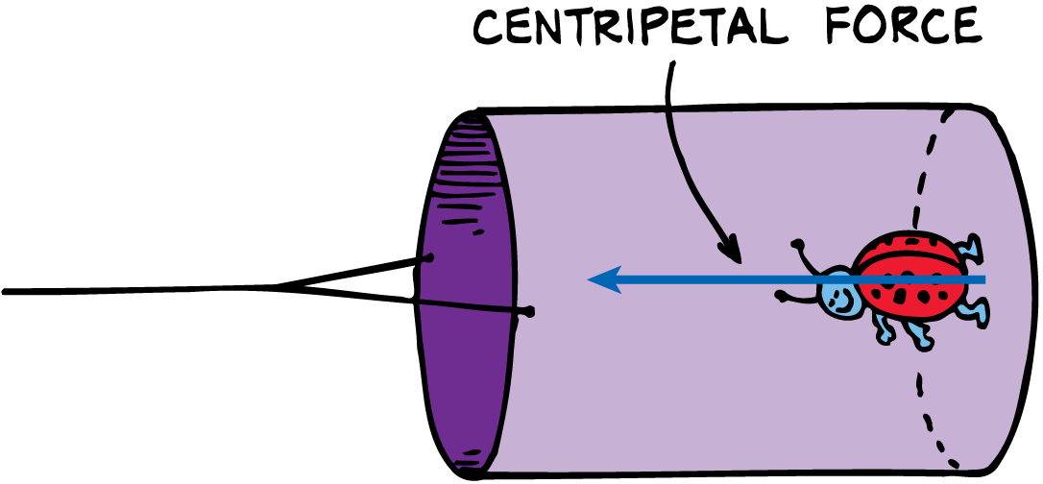
Centripetal and Centrifugal Forces
The can provides the centripetal force necessary to hold the ladybug in a circular path.

Slide 33
Centripetal and Centrifugal Forces
The can presses against the bug’s feet and provides the centripetal force that holds it in a circular path.
The ladybug in turn presses against the floor of the can.
Neglecting gravity, the only force exerted on the ladybug is the force of the can on its feet.
From our outside stationary frame of reference, we see there is no centrifugal force exerted on the ladybug.

